Slide 1
Automated Quadrat Analysis of Real-time USGS Earthquake Data
Dustin McGrew
GEOG 32641-01
Northwest Missouri State University

Slide 2
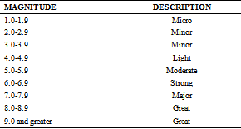
INTRODUCTION I
Earthquakes are a global geological phenomenon that have the capability for widespread destruction of urban and residential areas
They are mainly caused by tectonic plate fault lines being displaced due to stress, but they can also be caused by man-made explosives
The destructive potential for earthquakes is measured by magnitude scales (e.g., Richter)
The Richter magnitude scale.
Image Source: http://pubs.sciepub.com/jgg/5/4/1/Table/1

Slide 3

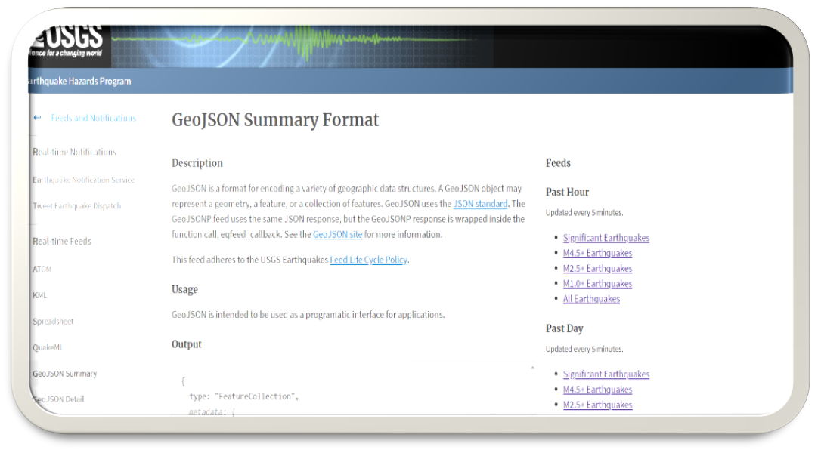
INTRODUCTION II
National and international agencies regularly monitor earthquake occurrences and provide easily accessible data
The United States Geological Service provides global earthquake point data in JSON text format that is regularly updated, queries can be filtered for selected time periods and magnitude levels
This data can be automatically imported into ArcMap for spatial analysis using the arcpy, json, and requests modules in python
An image of the USGS website providing links to Earthquake data and locations in JSON format.

Slide 4
The Problem
Earthquakes are notoriously difficult to predict by scientists due to the ambiguous and complex processes that are involved in the movement of the tectonic plates along fault lines
https://www.bbc.com/news/world-europe-20025626
Currently, like most other natural disasters, our best approach to the issue is rapid emergency response and planning before and after their occurrence
We cannot predict earthquakes with 100% certainty, but we can use spatial statistics and automated mapping services to track the amount of earthquakes and their spatial variability based on certain time periods
Most earthquakes normally occur on fault lines, but there have been many cases of “intra plate” earthquakes
Such earthquakes may provide an indication of where future earthquakes are likely to occur, so it important to track their spatial variability

Slide 5
JUSTIFICATION
It is essential for the individuals, organizations, and nations to monitor earthquake locations for the purposes of emergency response and planning
This python script presents a simple and effective means for monitoring earthquake frequency and regional variation without having to undertake more complex geologic analysis, the tool can be used indefinitely to get the latest earthquake data and locations
Quadrat analysis provides the best means for assessing the global spatial variability of earthquake locations, since other tools provided in geospatial software such as ArcMap are not designed for global scales

Slide 6
OBJECTIVE
Develop a python script to be imported in ArcMap that dynamically gathers global earthquake data from the USGS website based on user input parameters for time period and magnitude and creates a point shapefile to be used in further analysis
Perform automated quadrant analysis of global Earthquake locations based on user input parameters for quadrat cell height and width
The calculated VMR will aid in monitoring the regional variability of global earthquake locations
Increases or decreases in the VMR value for the same time period could indicate a change in the location of regional fault and intra-fault earthquake occurrences
Create a global map of earthquake locations for the selected time period and earthquake magnitude

Slide 7
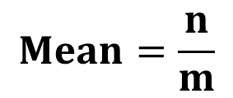

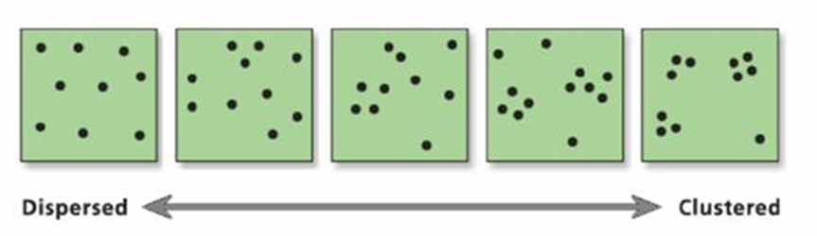
Quadrat analysis I
Quadrat analysis is a form of spatial analysis that compares the spatial pattern and frequency of data in separate grids
Results of the analysis are examined using the variance-mean ratio (VMR), which examines the relationship between cell frequency variance and the mean cell frequency
VMR patterns:
VMR > 1: clustered
VMR = 0: random
VMR < 1: dispersed

Slide 8
Quadrat Analysis II
The differences in point data frequency for each cell provides an indication of how the data is globally distributed across the grid, which is measured by the total variance of each cell
The mean density of points in a cell is necessary to calculate the variance-mean ratio
The variance-mean ratio (VMR) is a measurement that is designed to minimize the bias (due to point density) that is inherent in the absolute variance
The VMR value functions as a gradient, whereby the data points will become more clustered as the VMR increases, and a decrease in VMR values suggests that the data is more dispersed
The closer the VMR value is to 1, the more likely the distribution resembles random noise

Slide 9
Quadrat analysis III
f_{i} = the frequency of cells with i earthquake points
X_{i} = the number of earthquakes per cell
m = the number of cells
n = the number of earthquake data points
m = the number of cells

Slide 10
Main Processes
1) Gather input parameters from user
Workspace, shapefile, time period, magnitude, quadrat size
2) Query USGS website to get JSON text data
Adjust the query based on time period and magnitude
3) Store JSON text data in earthquake feature class variable
4) Add attribute data (fields) to the feature class using insert cursor
5) Create quadrat grid using fishnet function in arcpy
Adjust grid height and width based on user specifications
6) Perform spatial join on the grid layer with the earthquake feature class layer
7) Query the joined shapefile to get the aggregate statistics for each grid
8) (Optional) Generate a text file containing earthquake data points
9) (Optional) Generate a global earthquake map with quadrat grid
10) (Optional) Generate a program log containing earthquake statistics

Slide 11
Flowchart
Query URL
"https://earthquake.usgs.gov/earthquakes/feed/v1.0/summary/"
Input
Shapefile
Text Data File
Create FC
Input
Query JSON
Spatial Join
Statistics Analysis
Global Map
Input
Create Grid
Main functions (in order)
arcpy.CreateFeatureclass_management()
arcpy.AddField_management()
arcpy.da.InsertCursor()
arcpy.CreateFishnet_management()
arcpy.SpatialJoin_analysis()
arcpy.Statistics_analysis()
arcpy.mapping.MapDocument()
arcpy.mapping.ExportToPDF()
arcpy.Delete_management()
Program Log
Input
User inputs
ArcMap document
Query Time period
Query Magnitude
Quadrat Cell Height
Quadrat Cell Width
Generate text file?
Generate map?
Generate log?
*All outputs apart from the shapefile are optional.

Slide 12
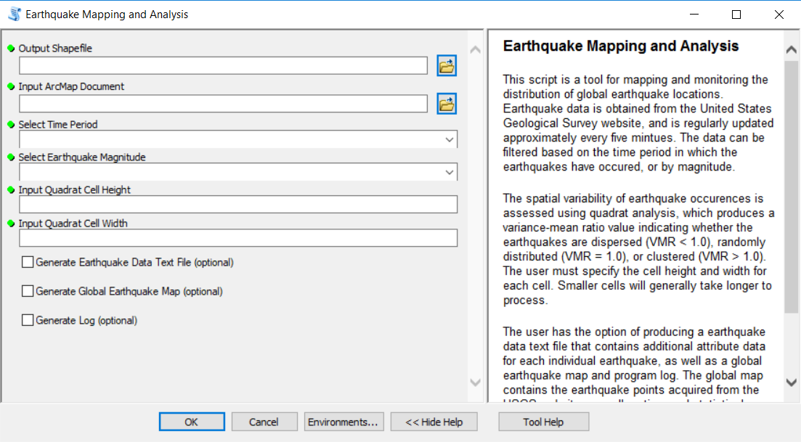
The Main Program

Slide 13
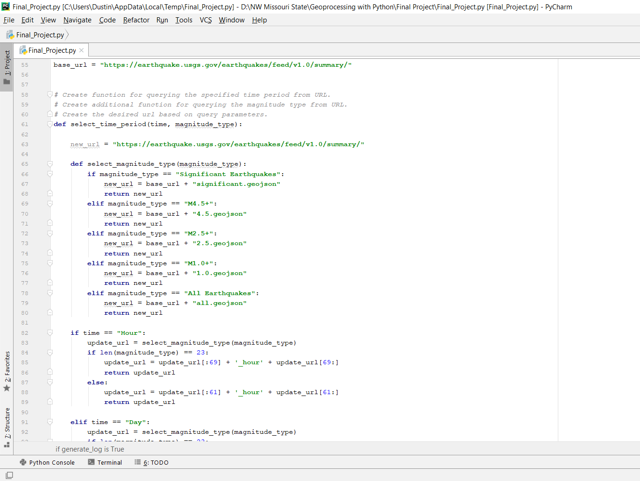
URL Query I
A base_url variable is created to contain the url that will be edited by inserting additional text specifying the time period and magnitude of earthquakes
Two custom functions are used to edit the url based on the user specified time period and magnitude for earthquakes
The main function will return the correct text which is then appended to the base_url

Slide 14
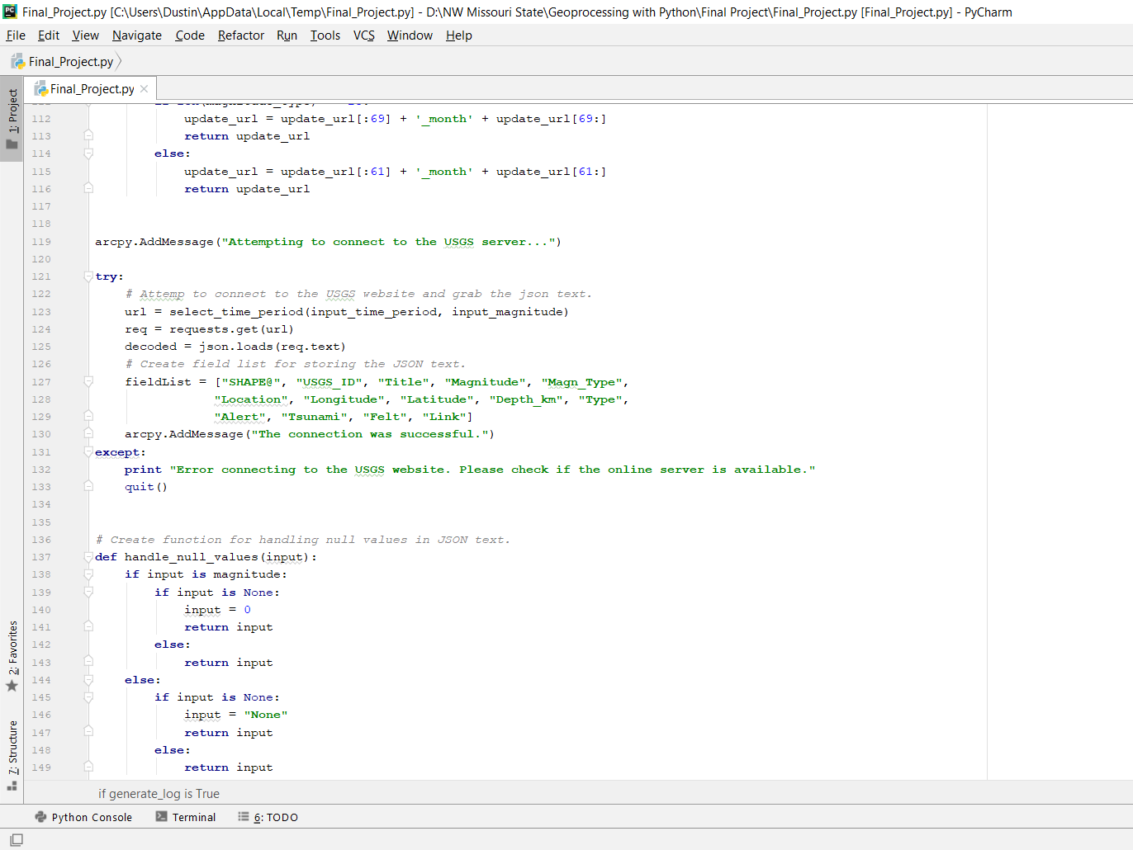
URL query II
A try and except clause is used to test the connection, and an error will be produced if the connection fails, followed by the program being terminated
The methods.get() method is used to pull the JSON text from the url, which is then stored in the “decoded” variable
A custom function is used to remove any null values that are acquired from the JSON text
It is important to remove these values since they cannot be imported into an ArcMap attribute table

Slide 15
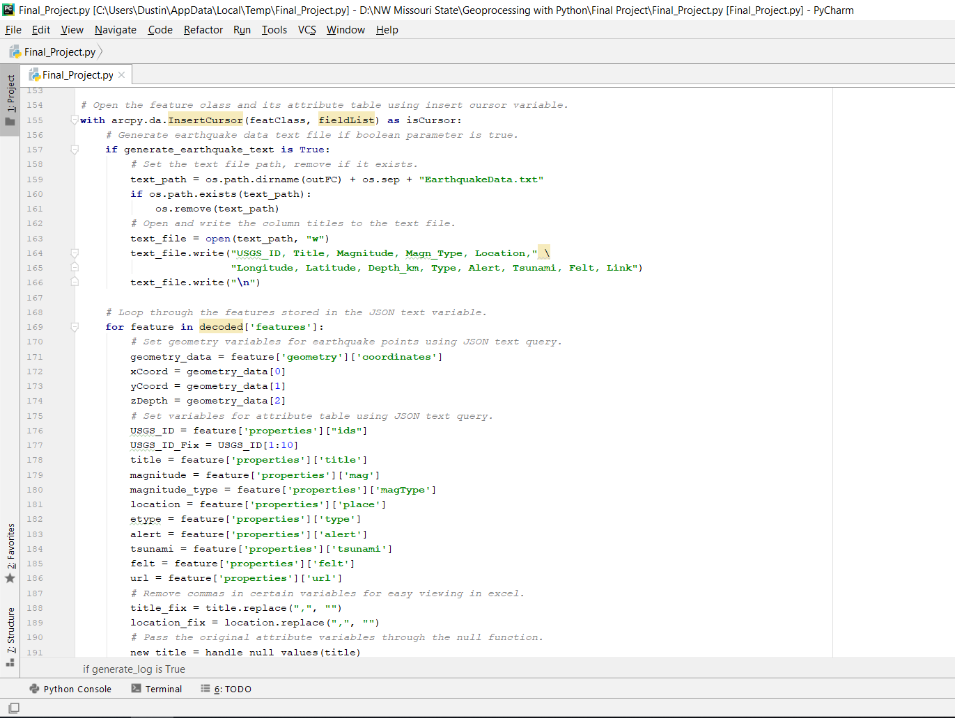
Create feature class
The shapefile is first created using the create feature management function, and insert cursor is then used to insert the fields and data gathered from the JSON text into the new shapefile
Data values are gathered from the JSON text using dictionary keys
An optional text file can be generated that contains additional meta data for each earthquake location

Slide 16
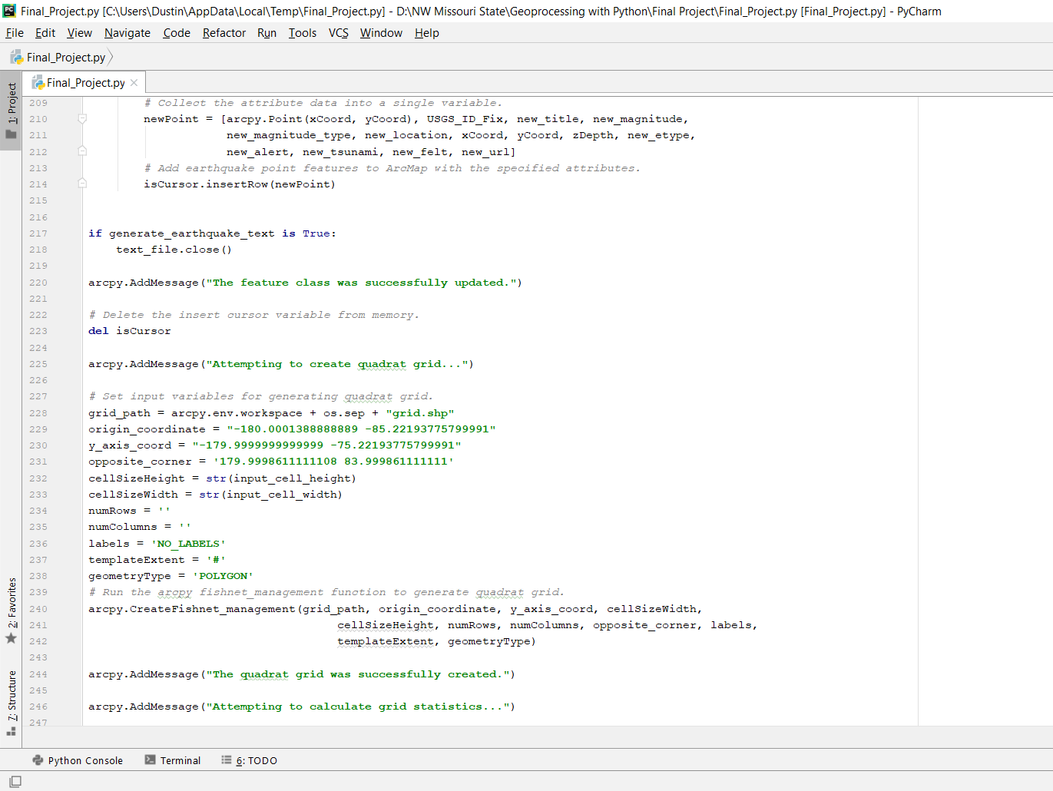
Create Quadrat Grid
The arcpy create fishnet management function is used to compute quadrat grids based on the cell height and width specified by the user
The extent of the grid has been predetermined based on the spatial properties of the map document so it does not require user input
The user should use caution when choosing the appropriate cell sizes, since smaller sizes will require a longer processing time

Slide 17
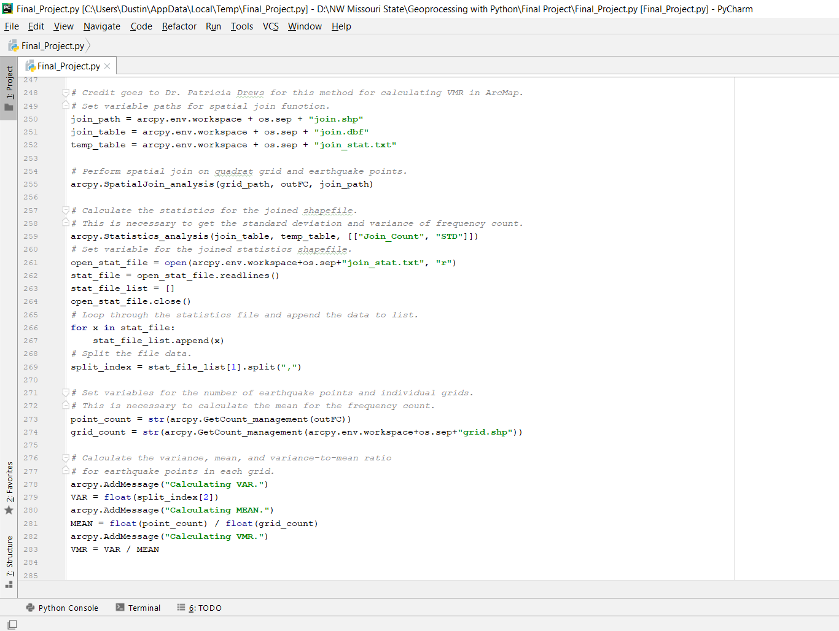
Calculate Statistics
The spatial join analysis function is used to join the quadrat grid and earthquake point feature class, which is then output as a temporary file
The statistics analysis function is then used to acquire the aggregate statistics (e.g., standard deviation) from the temporary file which is necessary to compute the variance in earthquake frequency for each cell
Finally, the variance, mean, and vmr is calculated for global earthquake locations

Slide 18
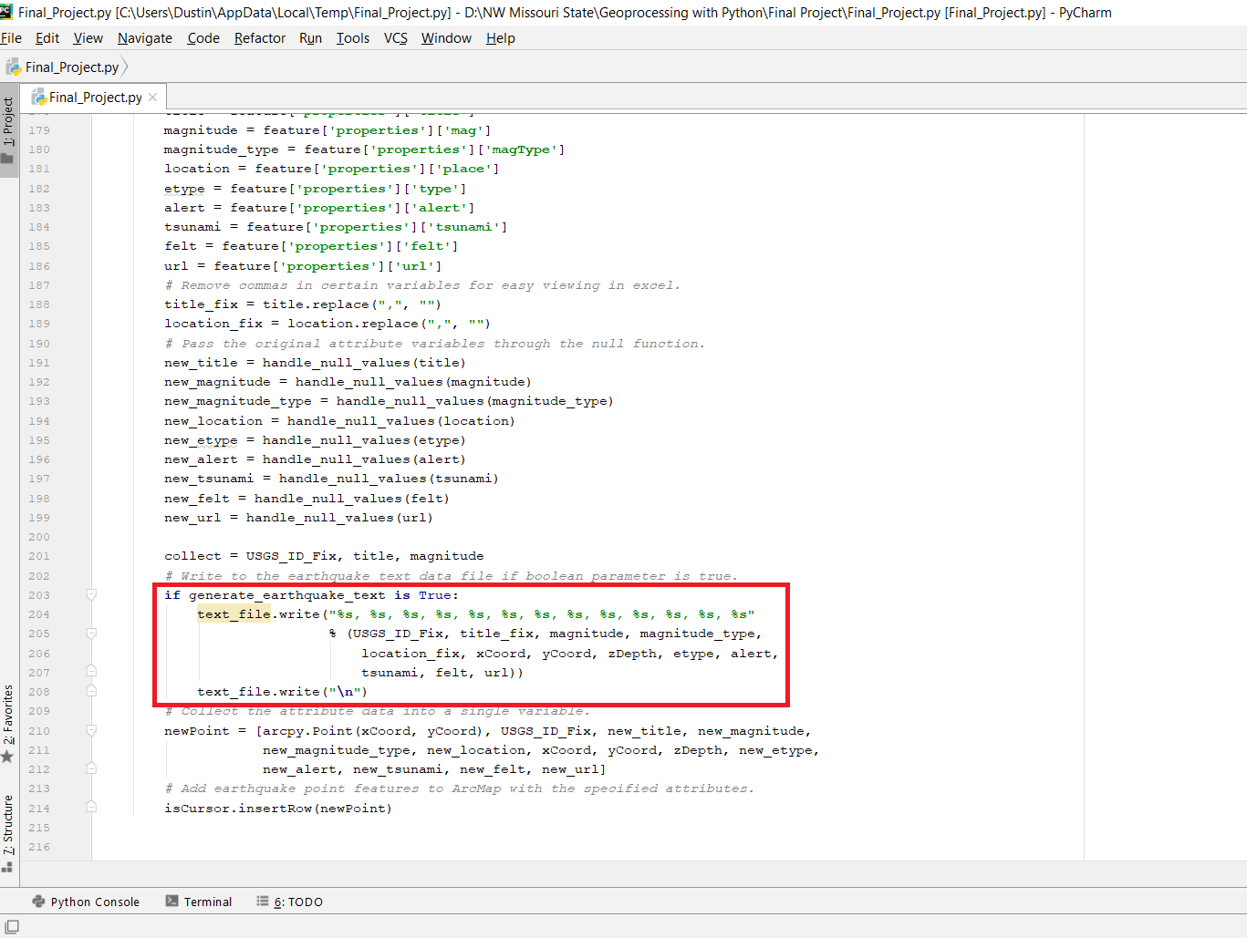
Generate Data Text File
The user has the option to generate a text file containing the meta data for each individual earthquake location
The text is formatted to be easily imported into Microsoft Excel using commas as delimiters

Slide 19
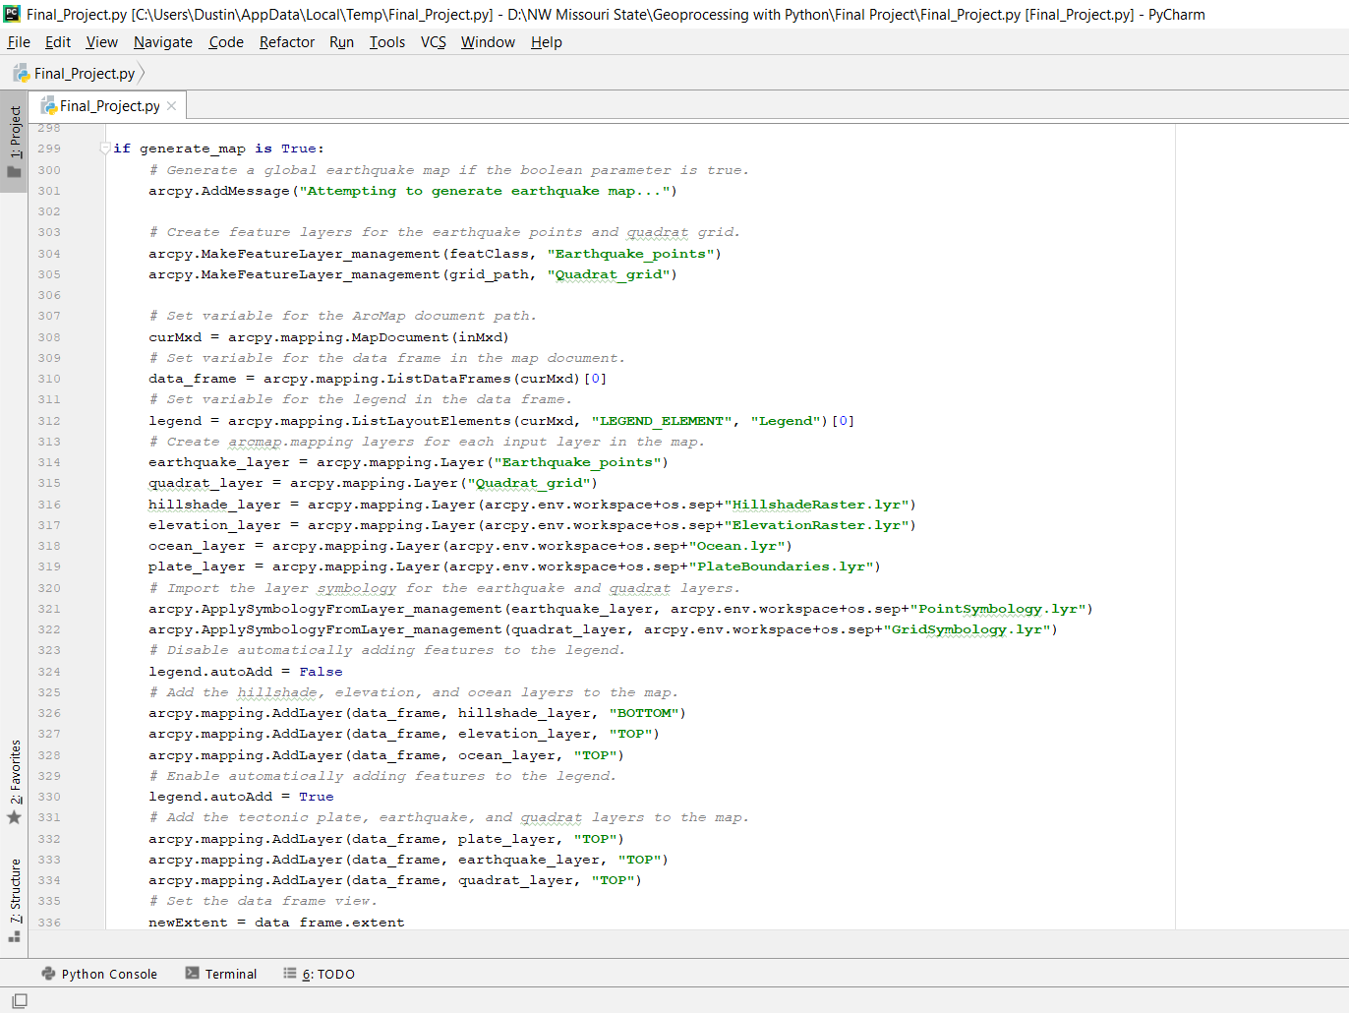
Generate Map
The user can decided whether to produce a global earthquake map detailing point data and quadrat grid
the arcpy.mapping function is used to automatically produce the map without any editing from the user
Most of the layers are included in the map document and are automatically loaded into arcpy when the map is created
Additional information such as the specified time period and magnitude, as well as earthquake statistics are dynamically added to the map when it is produced

Slide 20
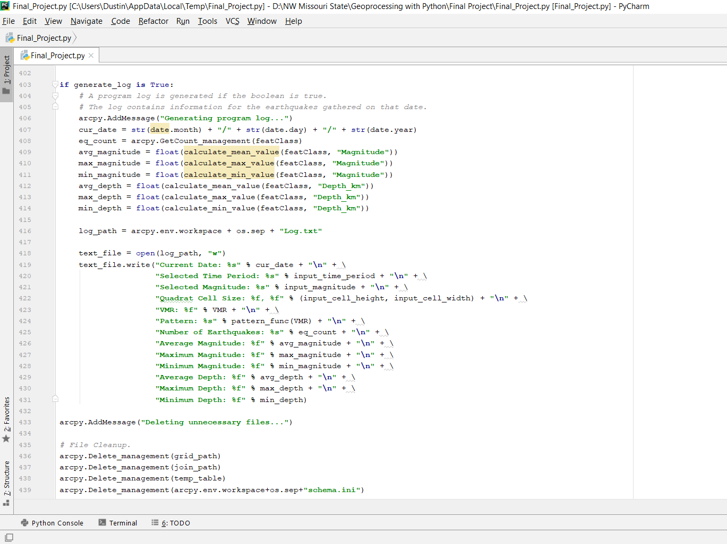
Generate log
Another option for the user is to generate a program log that contains time and statistical information
The log should be continually updated with the latest information each time the program is run

Slide 21
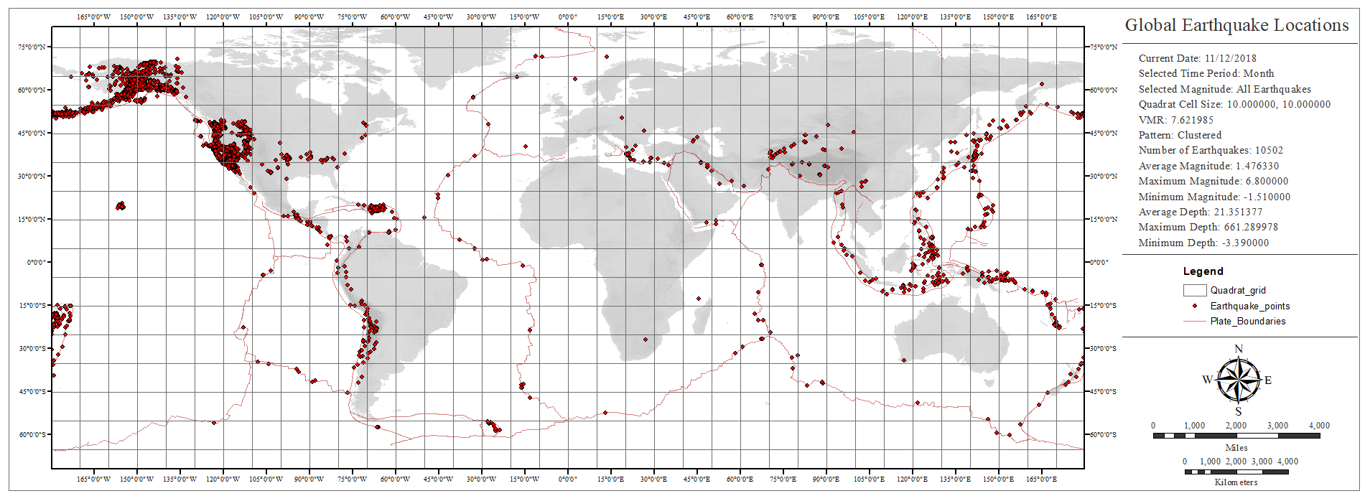
Results I
VMR = 7.6, Cell Size = 10,10

Slide 22
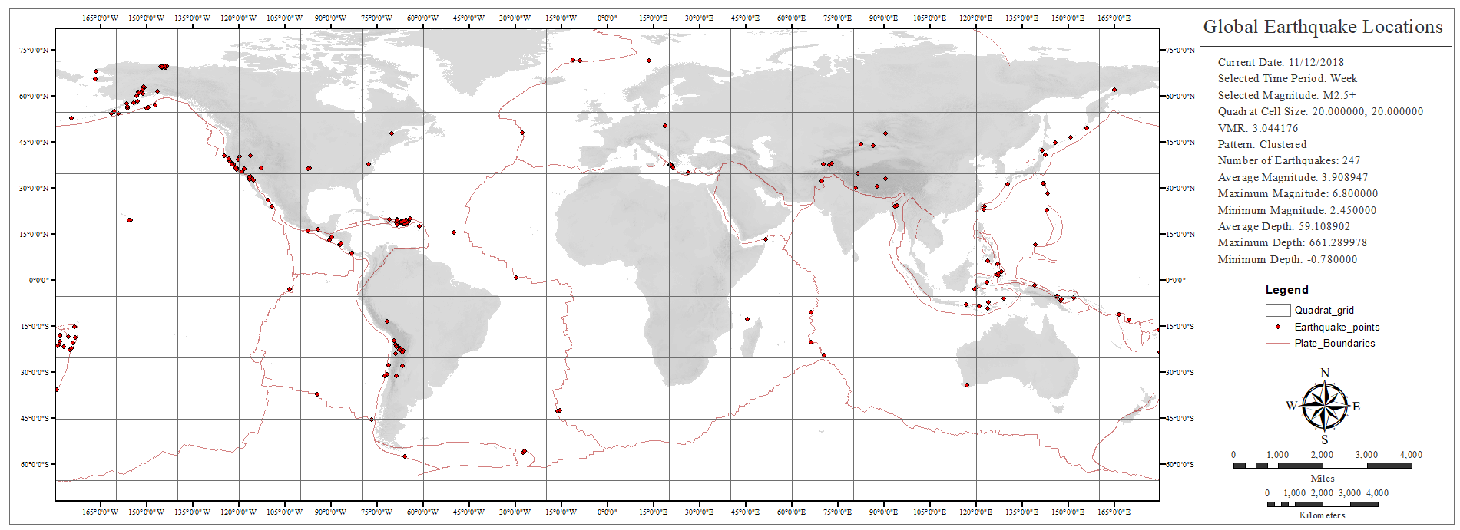
Results II
VMR = 3.0, Cell Size = 20,20

Slide 23
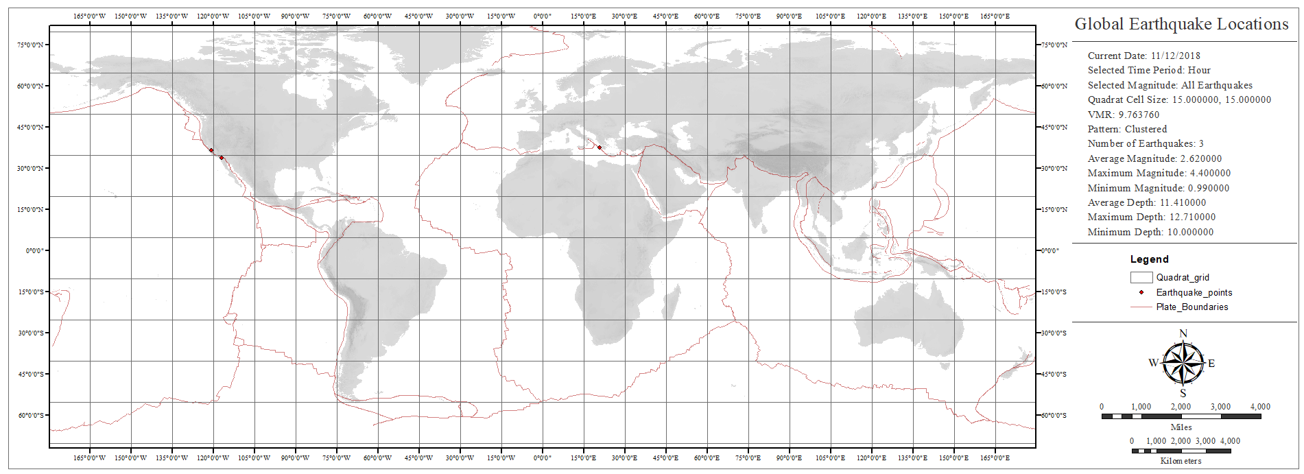
Results III
VMR = 9.8, Cell Size = 15,15

Slide 24
Technical Issues
The url for the USGS website is cases sensitive, and the script depends on the url remaining unchanged throughout its use
Thus, if the USGS website url is changed at any point in time by the administrator, then the script will require readjustment before further use
This is a drawback to the script as the user may not be familiar enough with Python to be able to edit the script
The quadrat cell size can affect processing times
A much longer processing time will be needed (depending on the computer’s processing power) if the user decides to use a smaller cell size for the grid
The script is setup in a way where the code will fail if the earthquake shapefile is output to any location other than the workspace folder included with the script

Slide 25
Conclusion I
This paper presents a tool for monitoring the location and spatial variability of earthquake occurrences
The script dynamically retrieves earthquake point data from the United States Geological Survey website, which is then used to create a point feature class in ArcMap software
The variability of earthquake point data is then assessed using pattern analysis, namely quadrat analysis which divides the study area into certain grids and compares the density of points in each cell
Results suggest that VMR may provide a good indication of global earthquake variability

Slide 26
CONCLUSION II
Earthquake locations are expected to be clustered around fault lines, thus the VMR value should be consistently large for all time periods
A decreases in the VMR value for the same time period indicates that the global distribution is becoming more dispersed
This can suggest an increase in the frequency of “intra-fault” earthquakes
An increase in the VMR value suggests an increase in the frequency of earthquakes occurring near fault lines
These results can aid policy makers and emergency response planners in developing a response to increased earthquake activity.

Slide 27
Further development I
Future development of the project can be divided into two categories, namely improvements in the methodology and refinement of the program itself
The script currently depends on the url remaining stationary and any administrative changes will disable future use
The program requires future development that will enable it to dynamically gather USGS data without relying on a linear function for selecting the correct url
The slow processing time involved when producing smaller cell sizes can be improved by introducing programming techniques that can boost performance.
One such technique is known as multithreading, which can significantly increase the performance for computers with multi-core processors

Slide 28
Further Development II
The quadrat analysis method has yet to be scientifically proven as an apt method for monitoring earthquake spatial variability
The methodology presented in this paper represents a hypothetical examination of possible analysis methods for earthquake observation
Regardless, the method is still based on the foundations of spatial statistics, so there should be observed consistency between data sets and their distribution
Future development should investigate whether the statistical data is representative of the inherent variability observed in the natural processes associated with earthquake locations and occurrences

Slide 29
Sources
McGrew, J. Chapman., et al. An Introduction to Statistical Problem Solving in Geography. Waveland Press, 2014.

